Slide 1
Spinning spanner ‘splains the spinning spinor
Grad Talk by Rohit Kumar Gupta

Slide 2

Candle Dance (1:40 sec)

Slide 3
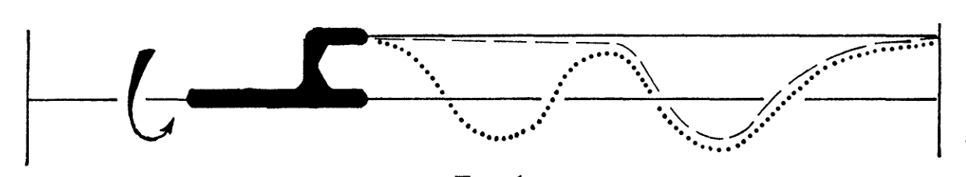
Dirac Spanner

Slide 4
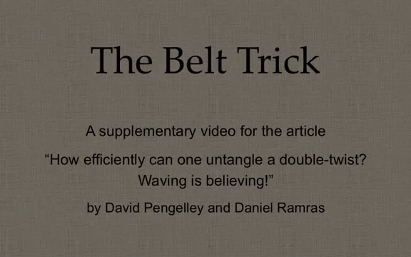
Belt Trick

Slide 5
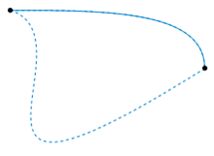
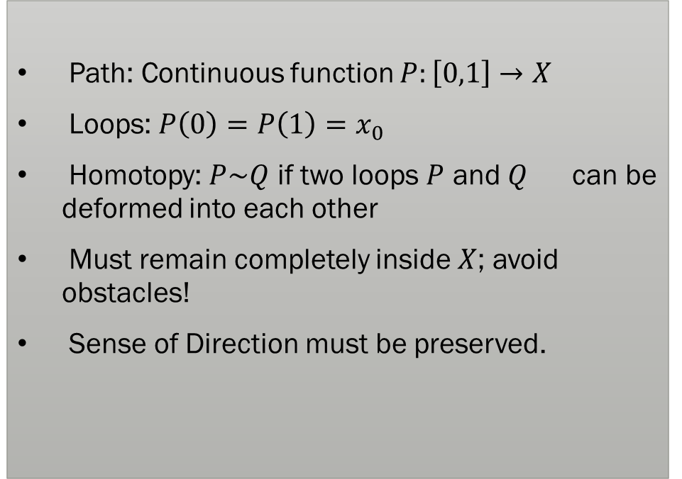
What is Homotopy?
Path: Continuous function $P:\left[0,1\right]→X$
Loops: $P\left(0\right)=P\left(1\right)=x_{0}$
Homotopy: $P\sim Q$ if two loops $P$ and $Q$ can be deformed into each other
Must remain completely inside $X$; avoid obstacles!
Sense of Direction must be preserved.

Slide 6
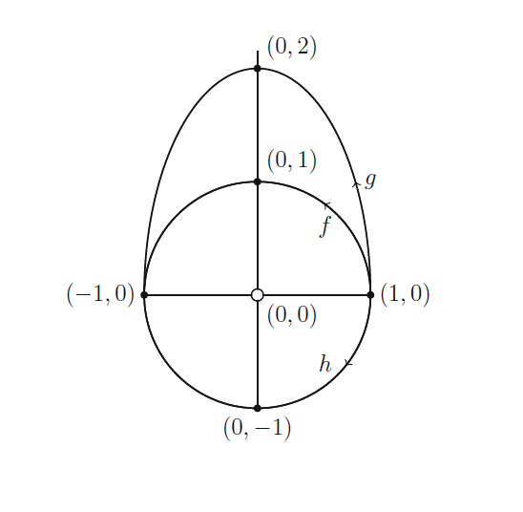
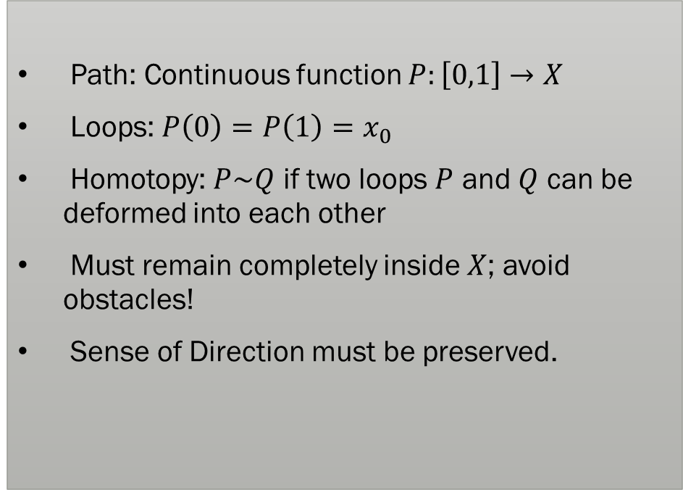
What is Homotopy?
Path: Continuous function $P:\left[0,1\right]→X$
Loops: $P\left(0\right)=P\left(1\right)=x_{0}$
Homotopy: $P\sim Q$ if two loops $P$ and $Q$ can be deformed into each other
Must remain completely inside $X$; avoid obstacles!
Sense of Direction must be preserved.

Slide 7
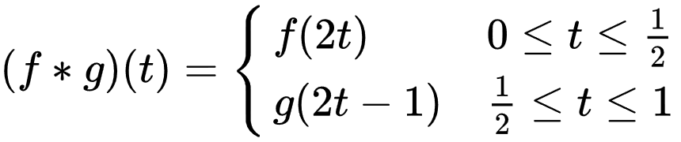

Fundamental Group
Two loops in succession with twice the speed
Zero Loop :

Slide 8
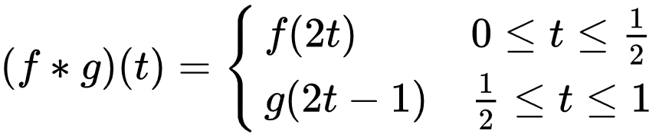
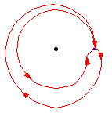
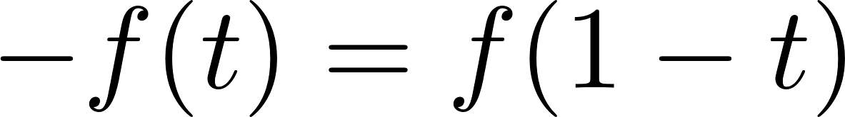
Fundamental Group
Two loops in succession with twice the speed
Zero Loop :
Inverse Loop:
Not necessarily abelian

Slide 9
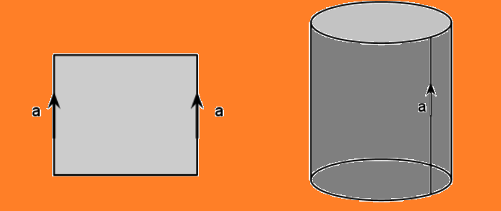
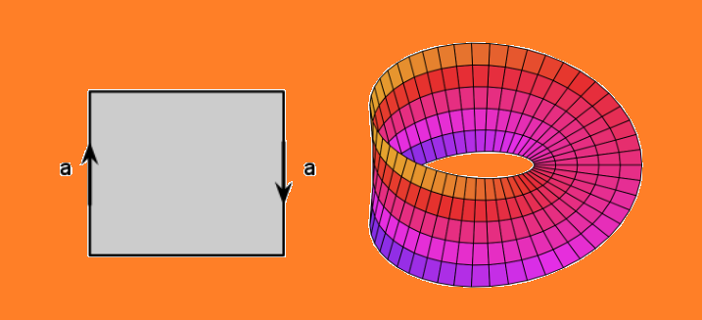
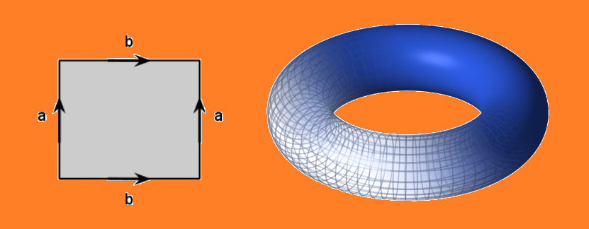
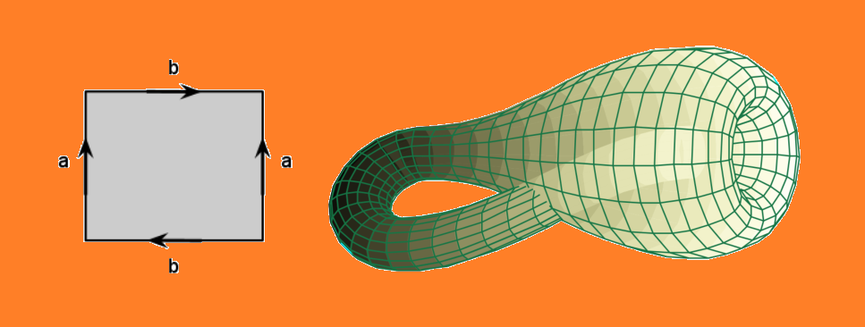
Pasting Edges of a Rectangle

Slide 10
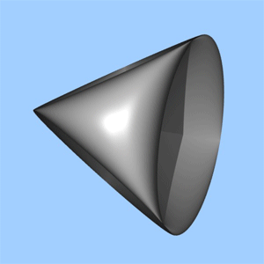
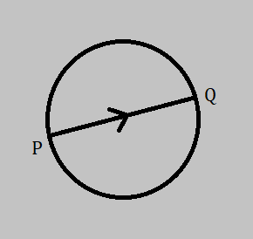
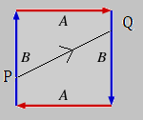
Projective Plane

Slide 11

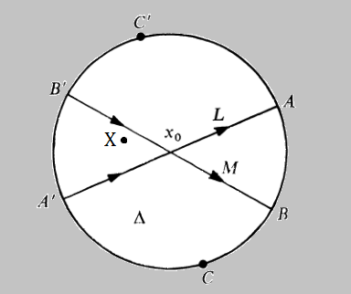
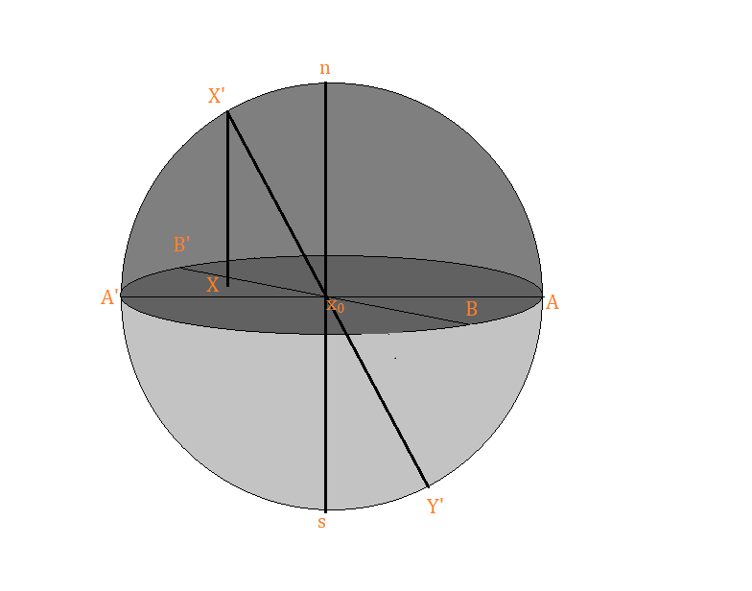
Projective Plane
Lift the disc D to the hemisphere (dark) H. D is homeomorphic to sphere S with antipodal points identified.
Projective space K along with disc D. Path P is defined to be

Slide 12
Projective Plane
Red line is the image of blue line on the sphere, note that red line is not homeomorphic to the blue line
Projective space K and the disc D along with path P.

Slide 13
Projective Plane
Projective space K and the disc D along with path P.
Red line is the image of blue line, because antipodal points are identified on the sphere

Slide 14


Projective Plane
Red line is the image of blue line, because antipodal points are identified on the sphere
The red line S is image of blue line P under homeomorphism.
Since S cannot be shrunk to a constant loop while keeping n and s fixed, and

Slide 15



Projective Plane
Red line is the image of blue line, because antipodal points are identified on the sphere
The red line S is image of blue line P under homeomorphism.
Since S cannot be shrunk to a constant loop while keeping n and s fixed, and
However is homeomorphic to the whole circle in red
Since , we can conclude that

Slide 16




Projective Plane
Let M and L be two directed diameters. Let the path Q follow M the same way P followed L.
We can rotated Q continuously such that it coincides with L. Thus and
If we take to be , then we conclude that

Slide 17












Topology of SO(3)
Let be the set of all points in , for example set of configurations of a rotating wrench or a rotating spinor.
One complete rotation of spinor corresponds to a loop in . We will prove that but .
Consider a sphere S centered at origin. Then each can be identified with the map , defined by the position of when S is moved to configuration .
is an isometry on S, because distances on sphere don’t change on rotation.
Since extends to a proper isometry on , must have a fixed point Proof of this statement is given in appendix.

Slide 18


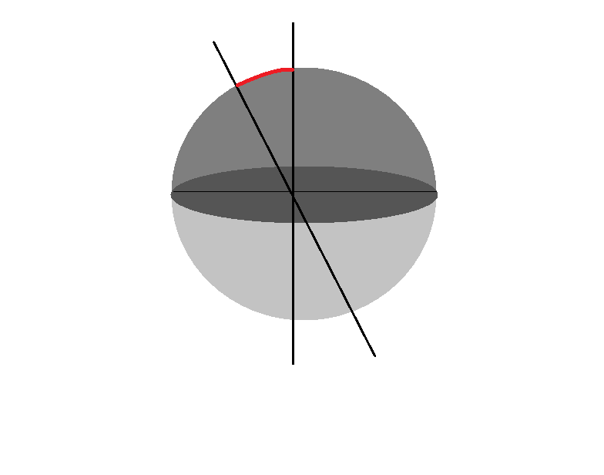







Topology of SO(3)
Let , this would mean that
Let have and as fixed points on the opposite sides of disc D. The sphere S can be brought into the configuration by a rotation of r radius about an axis passing through and .
Viewing the rotations from down on , any rotation is can be represented as an anti-clockwise rotation about the axis of magnitude between 0 and .
However since opposite points are identified, only rotations between 0 and are sufficient

Slide 19

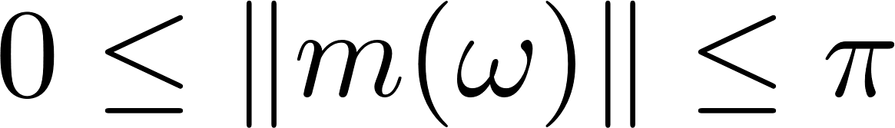
Topology of SO(3)
Rotation of spinor can thus be represented by a vector whose direction is from center of the sphere to and magnitude is .
Set of all forms a solid ball B of radius .
Since rotations of magnitude about V and –V are the same, opposite points on the boundary of B are identified.
Thus SO(3) is equivalent to a solid ball , with boundary points identified with their respective antipodal points.
A different proof of the same theorem can be written using quaternion algebra to represent rotations.

Slide 20
Loops in SO(3)
Consider a full rotation of the spinor about a particular axis L. As the amount of angle goes from 0 to , configuration of the spinor takes a path in the ball B from center O to the edge along L and back to O coming back from the other side, -L.
This loop P is analogous to the one we saw for projective plane.
To prove that , we construct a model analogous to previous case by considering the 3-ball in 4 space. We can stretch 3-ball to a hemisphere in 4-space and complete the 4-sphere.
Identifying the antipodal points on the boundary of the 4-sphere gives us a representation of SO(3) in 4-space.
Proof that and proceeds just like in the previous case.

Slide 21
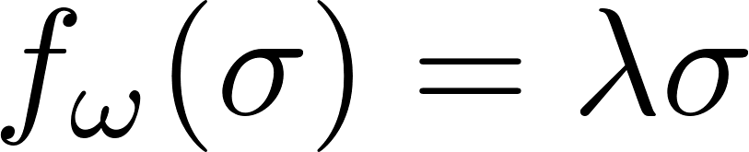

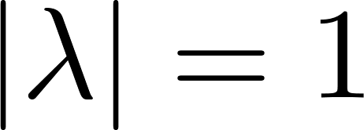

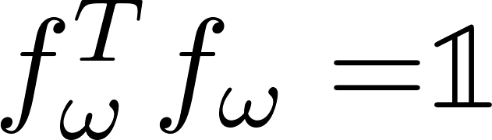
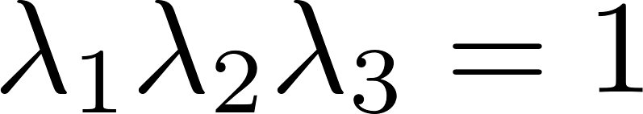

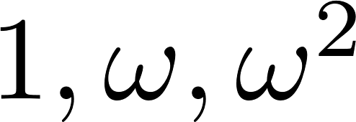
Appendix : has a fixed point
Proof: Let be the eigenvalue equation for the linear map .
Since , we can conclude that .
Since , we conclude that , thus det( ) = 1.
Since det(M) = product of eigenvalues, we conclude that .
Since , must be the cube roots of unity . Since 1 is one of the eigenvalues, must have a fixed point.

Slide 22
References
Ethan D. Bolker, The Spinor Spanner, The American Mathematical Monthly, Vol. 80, No. 9. (Nov., 1973), pp. 977-984.
Wikipedia contributors, "Homotopy," Wikipedia, The Free Encyclopedia, https://en.wikipedia.org/w/index.php?title=Homotopy&oldid=881471122 (accessed March 6, 2019).
Wikipedia contributors, "Real projective plane," Wikipedia, The Free Encyclopedia, https://en.wikipedia.org/w/index.php?title=Real_projective_plane&oldid=879484668 (accessed March 12, 2019).
Pandanggo sa ilaw - Candle Dance. Available at: https://www.youtube.com/watch?v=4Gf8Xa0N2yk

Slide 23
References
Crossley, M. (2010). Essential topology. London: Springer, p.51.
Rowland, Todd and Weisstein, Eric W. "Fundamental Group." From MathWorld--A Wolfram Web Resource. http://mathworld.wolfram.com/FundamentalGroup.html
Averett, M. (2018). Mathematical Cut-and-Paste: An Introduction to the Topology of Surfaces. [online] Mathcircle.berkeley.edu. Available at: http://mathcircle.berkeley.edu/sites/default/files/handouts/2018/topology_of_surfaces_2018_0.pdf [Accessed 6 Mar. 2019].
Pengelley, D. (2016). The Belt Trick. [online] YouTube. Available at: https://www.youtube.com/watch?v=Vfh21o-JW9Q [Accessed 14 Mar. 2019].

